Slide 1
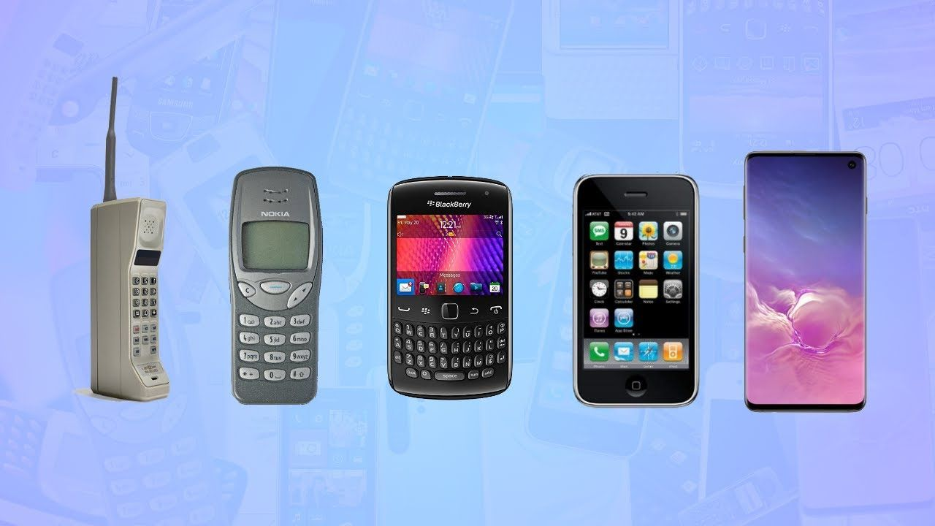
Mobile Phone Prices
by Anthony Tan

Slide 2
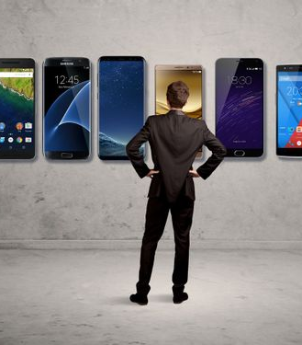
Agenda
Background
Business Question
Data Analysis
Model Evaluation
Conclusion

Slide 3
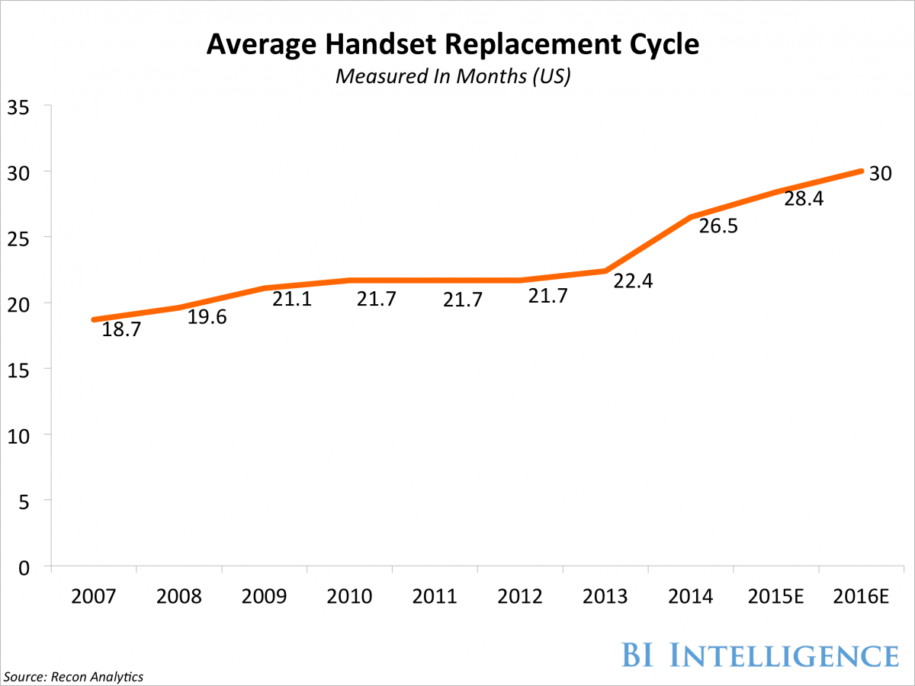
The Upgrade Cycle

Slide 4
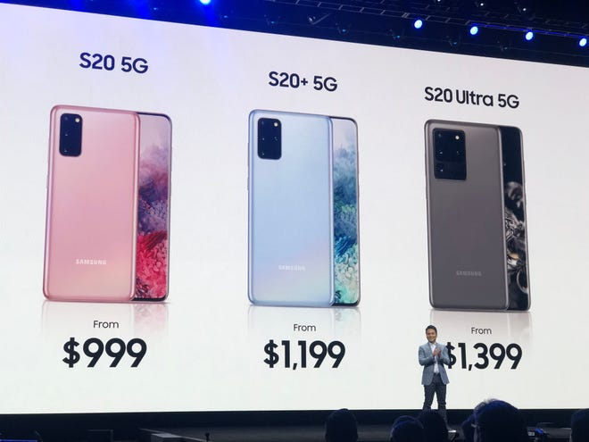
Overpricing vs. Underpricing
Overpricing
Too high mark-up can alienate customers and narrow target market
Underpricing
Too low can devalue the product and customer perception of quality

Slide 5

Business Question
What technological features determine optimal phone price?

Slide 6
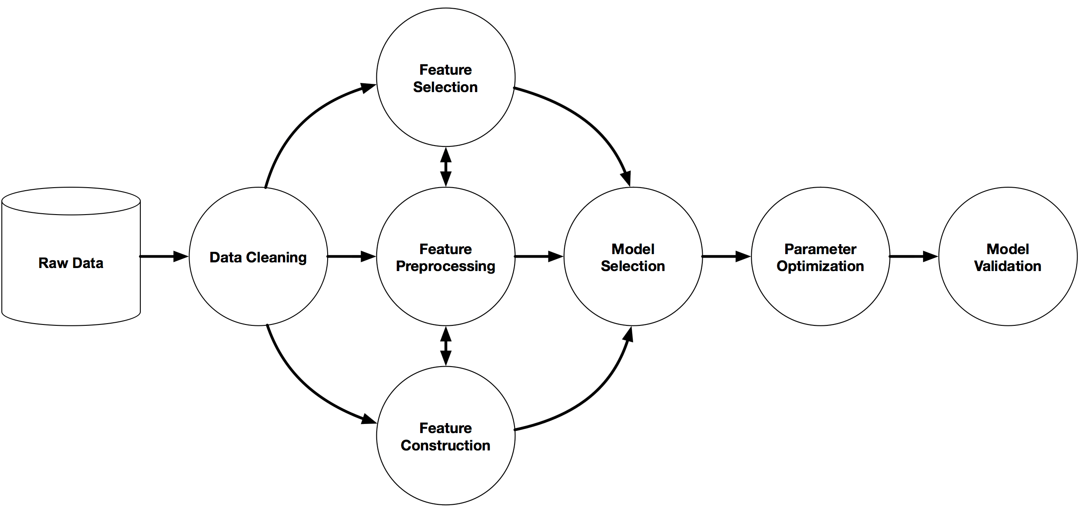
Pipeline

Slide 7
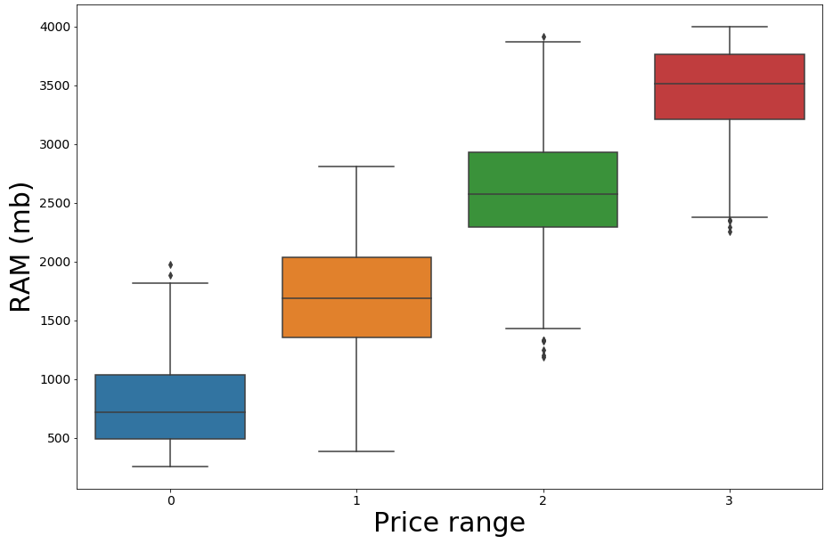
Data Analysis
Price Class | Price Range
0 (Low Range) | Less than $400
1 (Mid Range) | $400 - $899
2 (High Range) | $900 - $1499
3 (Very High Range) | $1500 or more

Slide 8
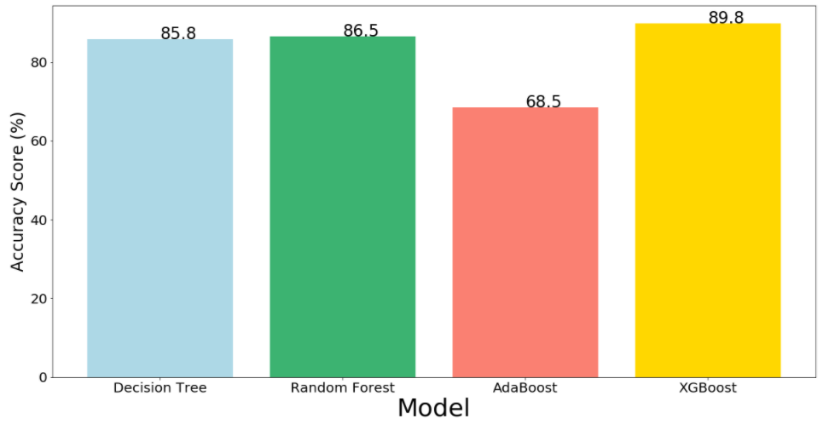

Model Comparison

Slide 9
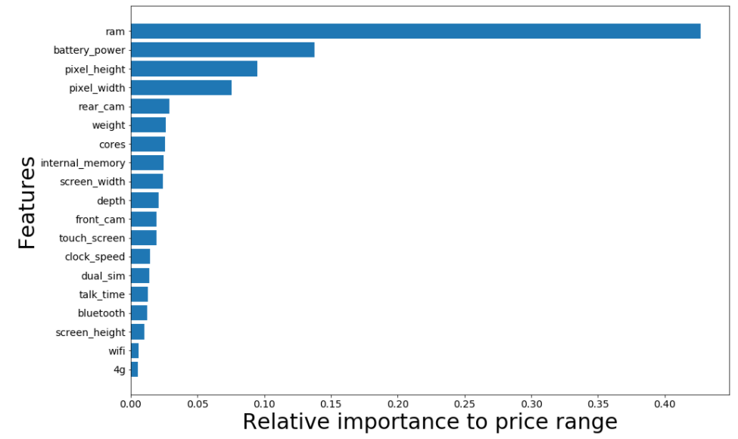
Feature Selection and Parameter Tuning
Parameters
Feature importance threshold: 0.015
Features used: 12
Maximum depth: 7
Accuracy
Before: 89.8%
After: 90.5%

Slide 10
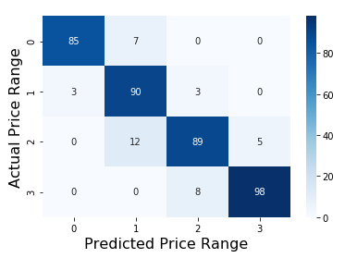
Accuracy by Price Category
Price Range | Precision
0 (Low Range) | 96.6%
1 (Mid Range) | 82.5%
2 (High Range) | 89.0%
3 (Very High Range) | 95.1%

Slide 11

Conclusions
RAM, battery power, and display technology had the highest impact in calculating price.
Highlight value of stronger performance and technological enhancements to justify higher price.

Slide 12
Summary
Objective
Determine optimal price by evaluating phone features
Process
Recommendations
Demonstrate value of most impactful features
Narrow down features to improve prediction accuracy

Slide 13


